Slide 1
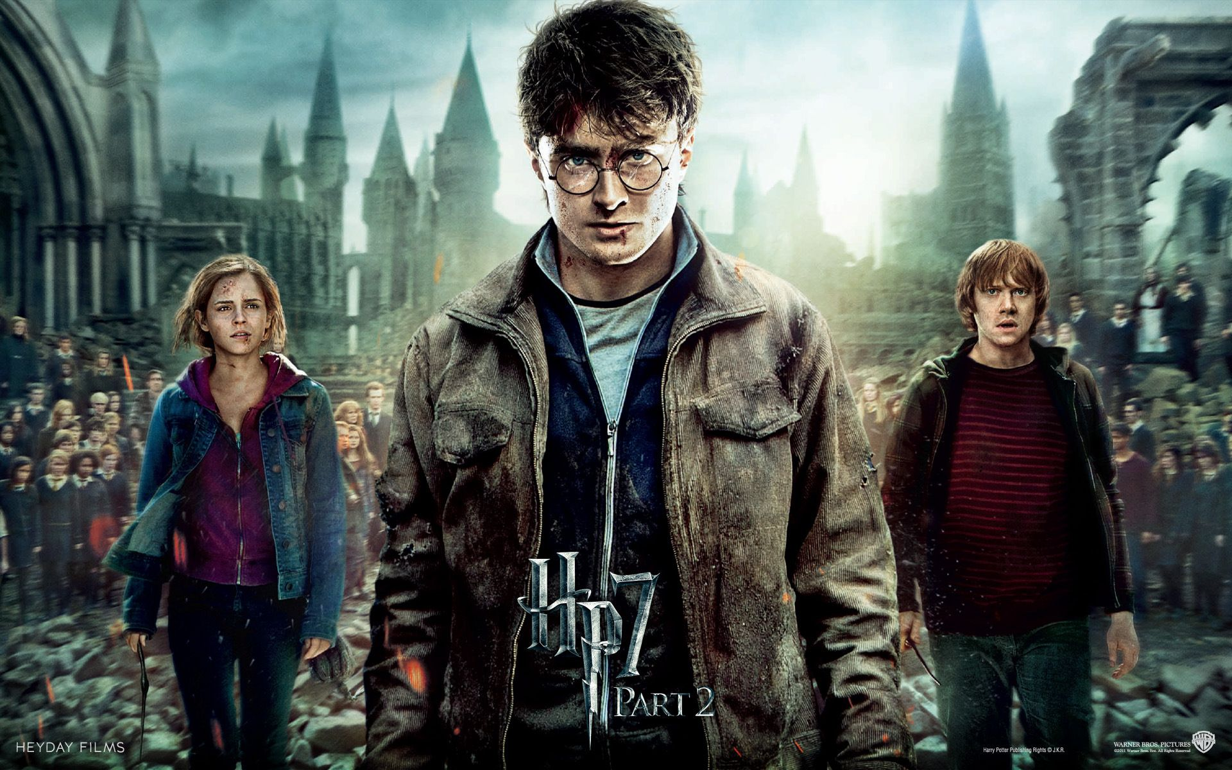
HARRY POTTER MOVIE SCRIPT
Presented by : Nirmal Joy
Last updated : January 29 2022

Slide 2
Table OF contents
HARRY POTTER MOVIE SCRIPT
Purpose Of Statement(What are we talking about)
Tell Story(With Data)
Conclusion
Appendix
Data Summary

Slide 3
data summary
Harry Potter is a film series based on the eponymous novels by J. K. Rowling. The series is distributed by Warner Bros. and consists of eight fantasy films, beginning with Harry Potter and the Philosopher's Stone (2001) and culminating with Harry Potter and the Deathly Hallows – Part 2 (2011). A spin-off prequel series that will consist of five films started with Fantastic Beasts and Where to Find Them (2016), marking the beginning of the Wizarding World shared media franchise
Harry Potter is an orphaned boy brought up by his unkind Muggle (non-magical) aunt and uncle. At the age of eleven, half-giant Rubeus Hagrid informs him that he is actually a wizard and that his parents were murdered by an evil wizard named Lord Voldemort.
one of the most successful movie franchises of all-time, Harry Potter!

Slide 4
What are we talking about?

Slide 5
Objective
Evaluating the movie dataset through the different aspects of Budget , Movie , dialogue , spells and get summary of this movie data scripts

Slide 6
Present Data

Slide 7
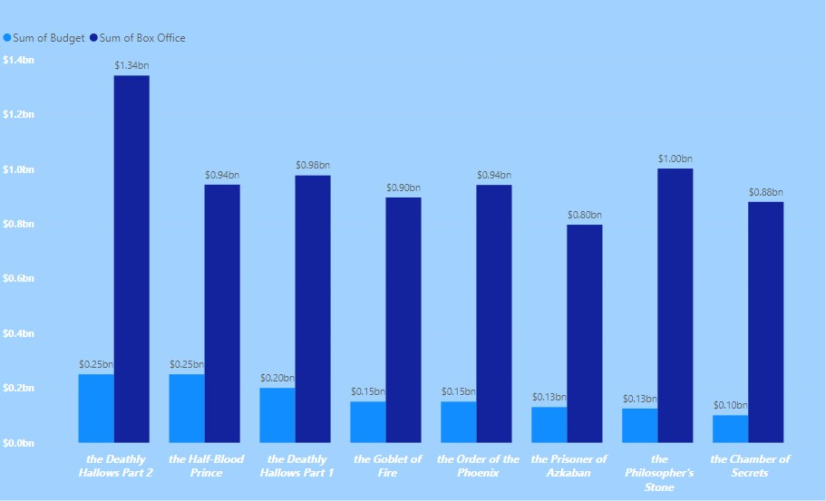
Box office vs budget

Slide 9
Box office vs budget
→ The film Harry Potter and the Deathly HallowsPart 2 was a commercial success and one of the best-reviewed films of 2011
→ Part 2 grossed over $1.3 billion worldwide and became the third-highest-grossing film at the time, as well as the highest-grossing film of 2011
→ Life Time Grosses of the all Harry potter movies is $7.8 billion

Slide 10
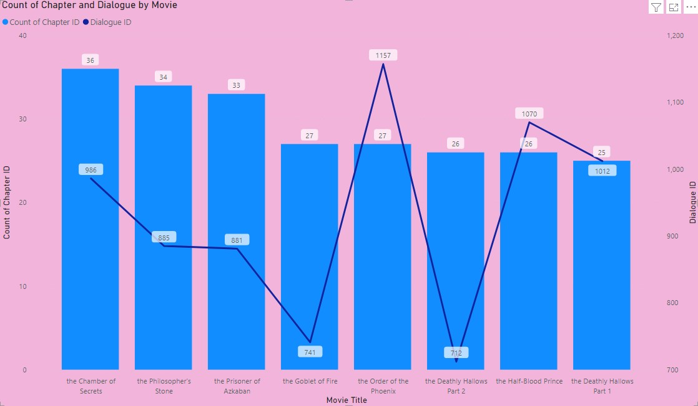
Movie , Chapter ,dialogue

Slide 12
Movie , Chapter ,dialogue
→Harry potter and the Chambers of Secret Movie has the most number of Chapters In this Series
And it is the longest movie
→In this dataset 7,444 lines of dialogue from the 8 Harry Potter movie scripts.
→Harry potter and the order of the Phoenix has the highest number of dialogue

Slide 13
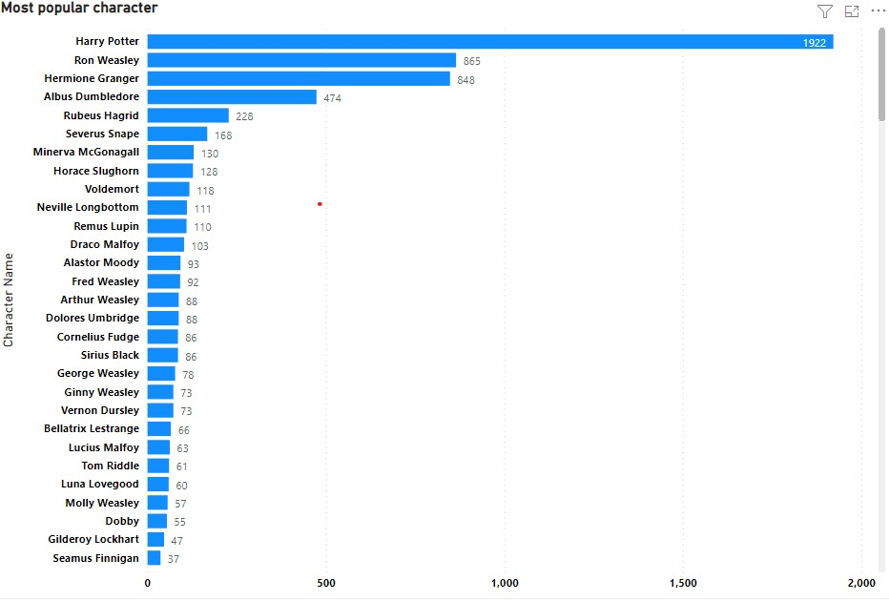
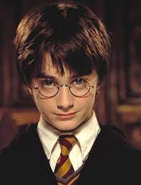
Most popular character
→Harry James Potter is a fictional character and the titular protagonist in J. K. Rowling's series of Harry potter Movies
→Harry potter Is the Most popular Character that he has the Most number of Dialogues and used most number of Spell

Slide 14
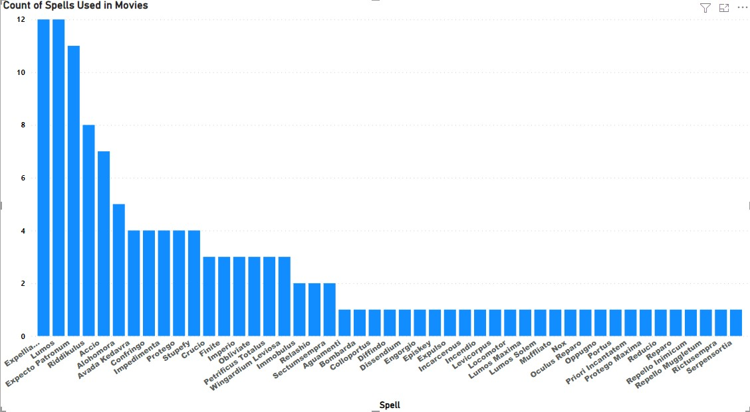
Spell
→Expelliarmus is the most commonly utilized spells in the series and ranks high on the list
→Expecto Patronum is the most popular spell in the film series
It is also the favorite spell of the protagonist in this Movie
→Blue color is the most light emits from the spell

Slide 15
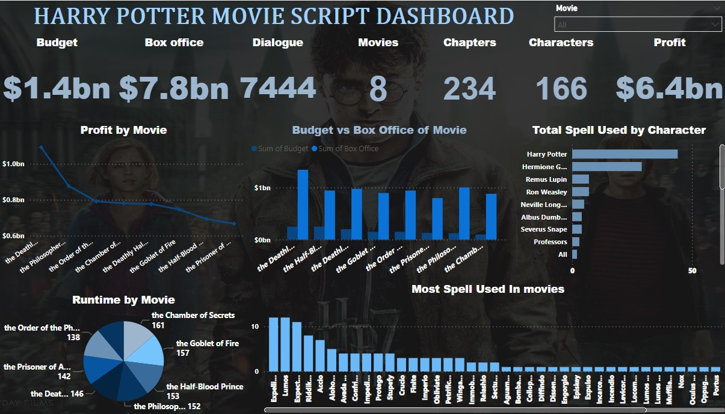
POWEr-bi dashboard

Slide 16
Conclusion

Slide 17
Conclusion
The film Harry Potter one of the most successful movie franchises of all-time, and one of the best-reviewed films of 2011
1
2
Harry Potter Movie has the 234 chapters and Harry potter and the Chambers of Secret Movie has the most number of Chapters In this Series
2
3
3
Harry potter Is the Most popular Character
4
There are 61 Spells In the Movie Harry potter and Expelliarmus is the most commonly utilized spells in the series and ranks high on the list
4

Slide 18
Thank You

